Slide 1

Receipt Keeper
Receipt Management Application
Changho Choi
Hassan Nahhal
Nicholas Collins
SungJoe Kim
Mobile Solutions Development

Slide 2
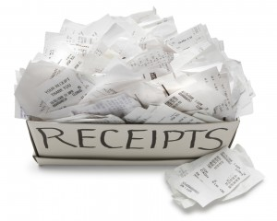
Introduction
Be familiar with spending
Avoid impulse buying
Manage your money
Save you time & effort
Here’s the way …
Notes:
Sequence
Introduction / Agenda : Hassan
Problem/Solution : Nick
Tech. : Chang
Mobile Features : Hassan
Web Features : Joe
Plan/Conclusion :Nick
Introduction : Hassan will prepare expression and proper images

Slide 3

Agenda
Problem
Solution
Technologies
Methodologies
Features (mobile/ web)
Future plans
Conclusion
Notes:
What’s it (This slide is not necessary)

Slide 4



Problem
Forget stuff bought
Tracking all of this is a handful
Strict budget
Alternative is not ultimate
A long process to start using it
Offer limited functions
Focused on private, personal use
Notes:
Here’s Nick

Slide 5




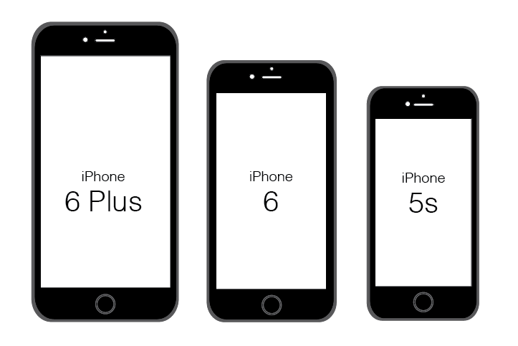


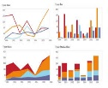
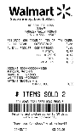
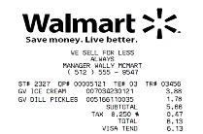
Our Solution
Quick & easy access to start
No extra devices required
Scan receipt & store it Online
Filter, Search for receipts, export as files
Generate charts, reports feedback
Support working in groups

Slide 6






Work Process
Scan
receipt
Output
data
Save in
database
Track
expenses
View
anywhere
Notes:
From here, Chang

Slide 7




















Technologies
BAAS
DAAS
Web
PAAS / SVC
Mobile

Slide 8



Methodologies
Development Methodologies
Agile Unified Process (2 weeks iteration)
Source Control & Change Management
3 GitHub repositories
Master and branch (dev_prod)
Wiki to keep track of outcome
Issues tracking to assign fixes or tasks
Communication
Slack and regular meetings
Notes:
Use Icon to explain above text descriptions
Modify and improve from Chang and add proper images

Slide 9

Technical Diagrams
User
Receipt
File
*
*
1
1
0..
*
<<belongs to>>
0..
<<belongs to>>
Store
*
0..
Group
Tag
*
0..
*
0..
<<belongs to>>
Category
Notification
Details

Slide 10

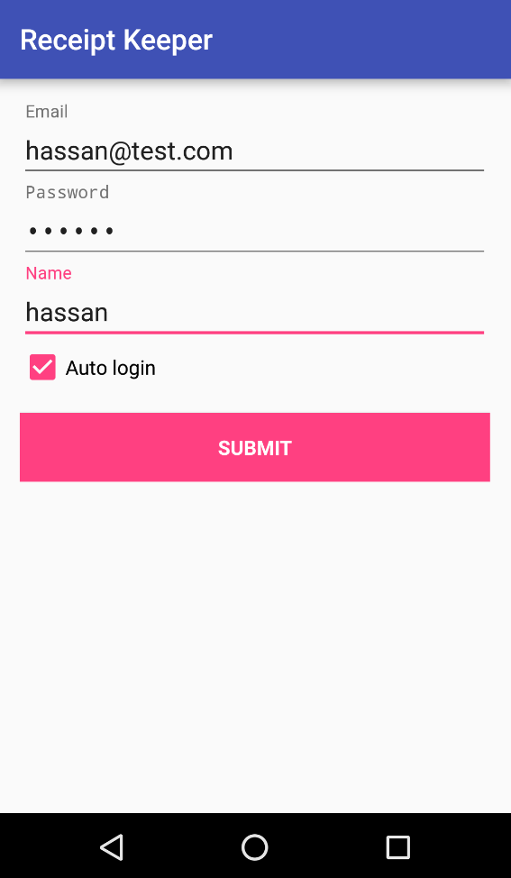
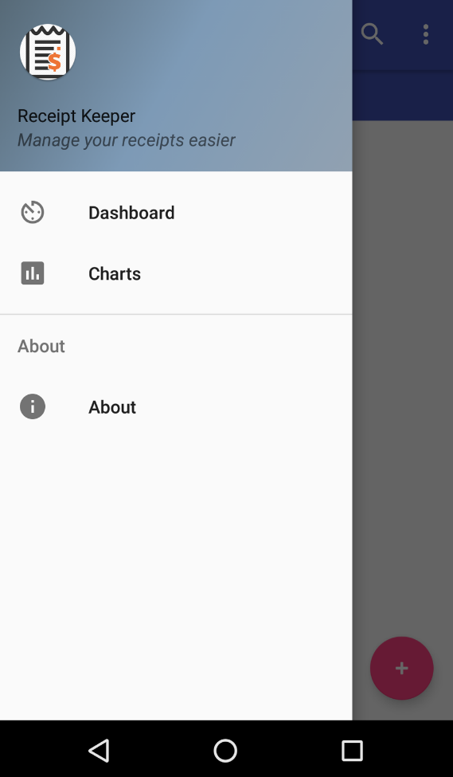
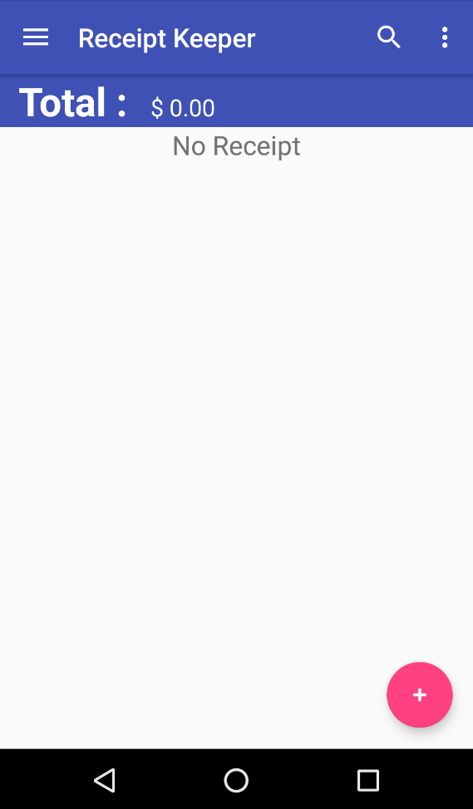
Features (mobile app)
Sign In/Up
Main Page
Sliding view
Notes:
From here : Hassan
Screenshots for major actions and short words

Slide 11
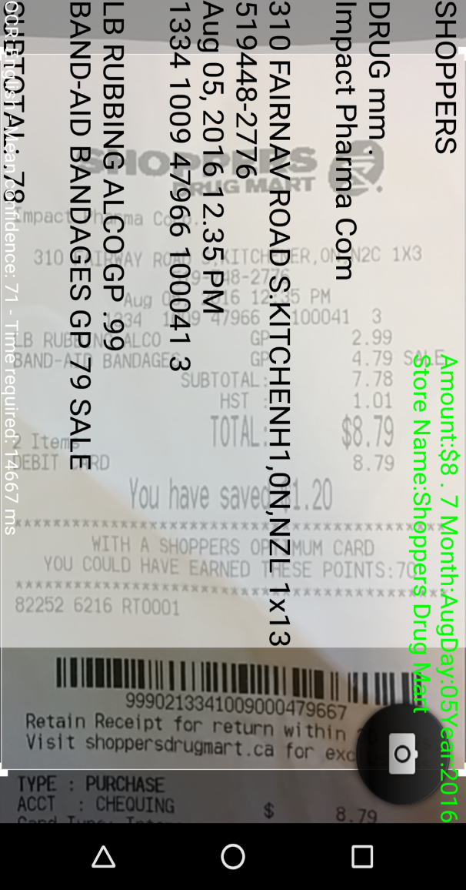
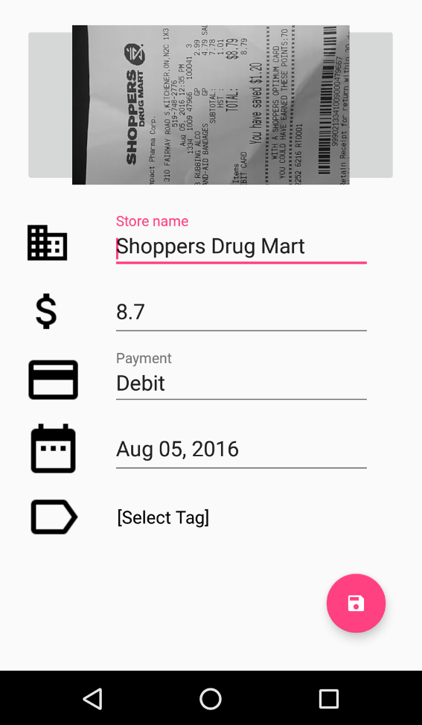
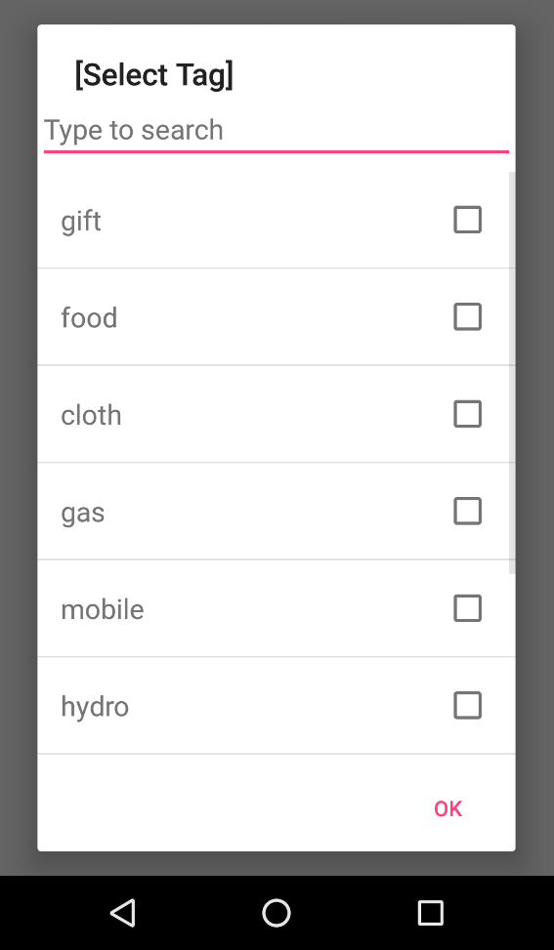
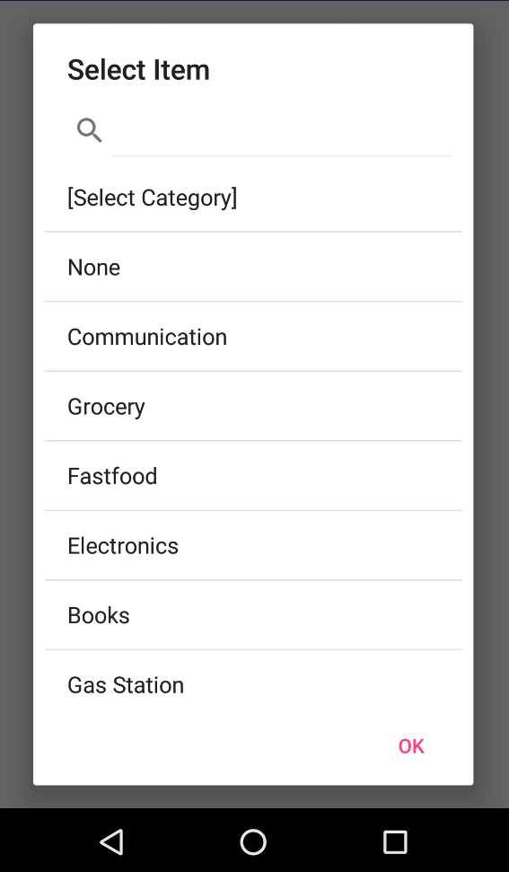
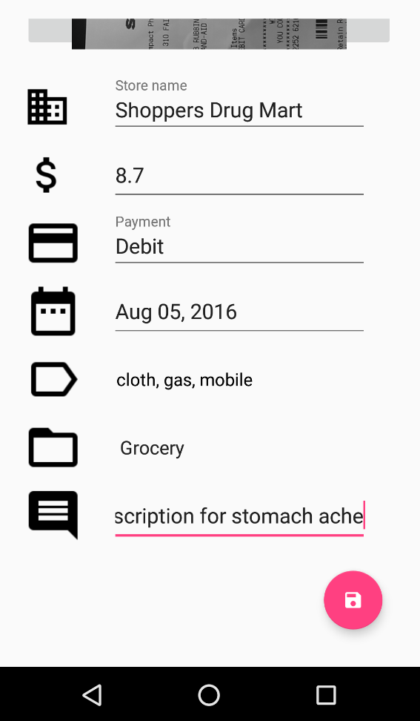
Features (mobile - cont.)
Add tag
Select category
Save
Data gathered
Scanning receipt

Slide 12
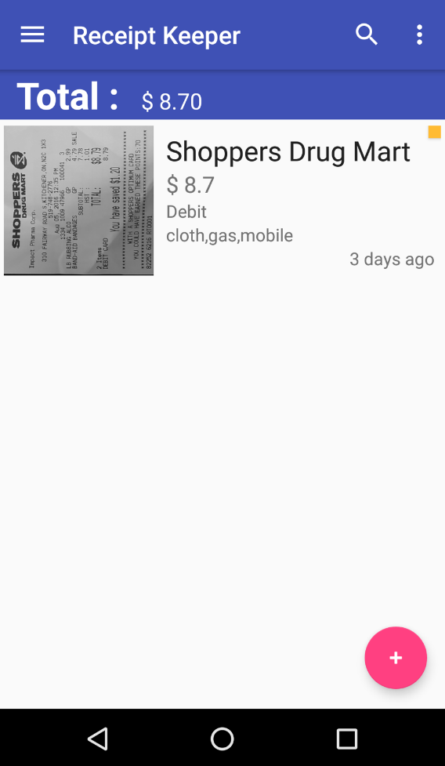
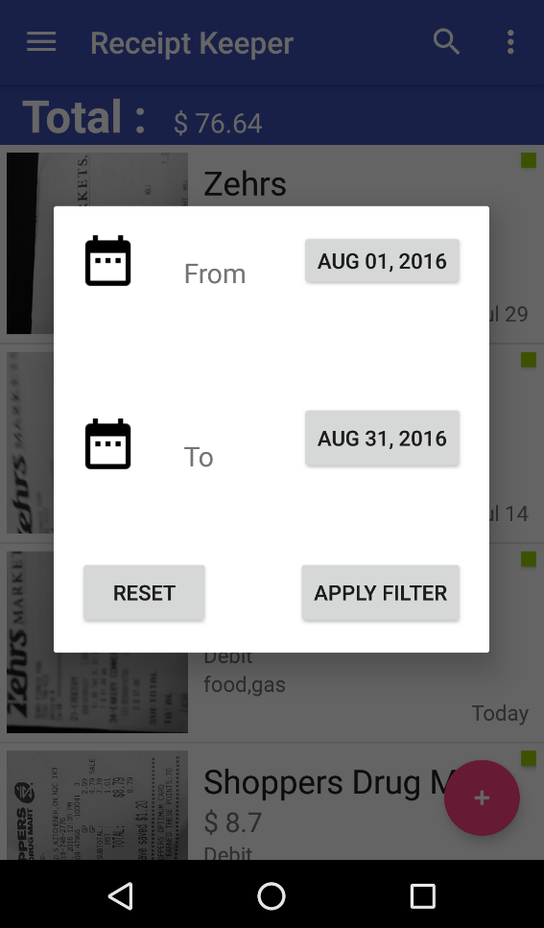
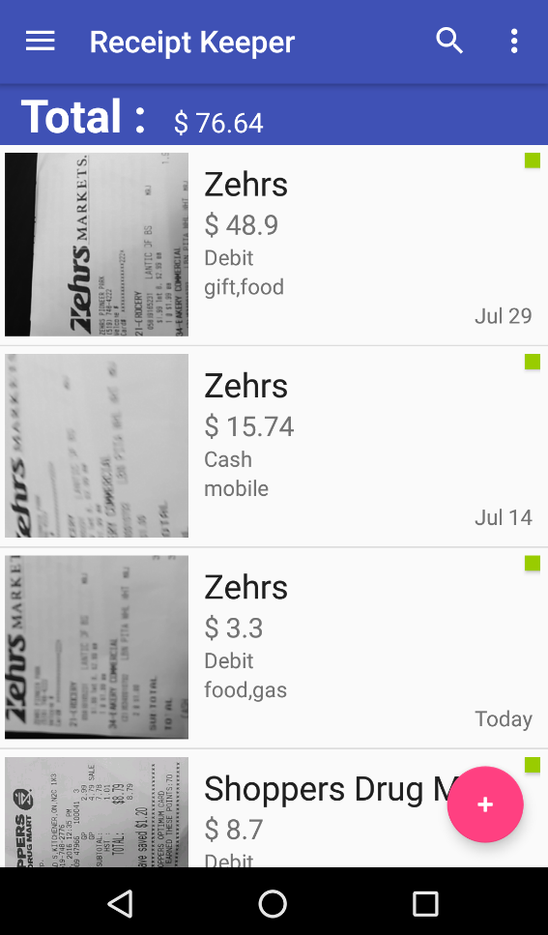
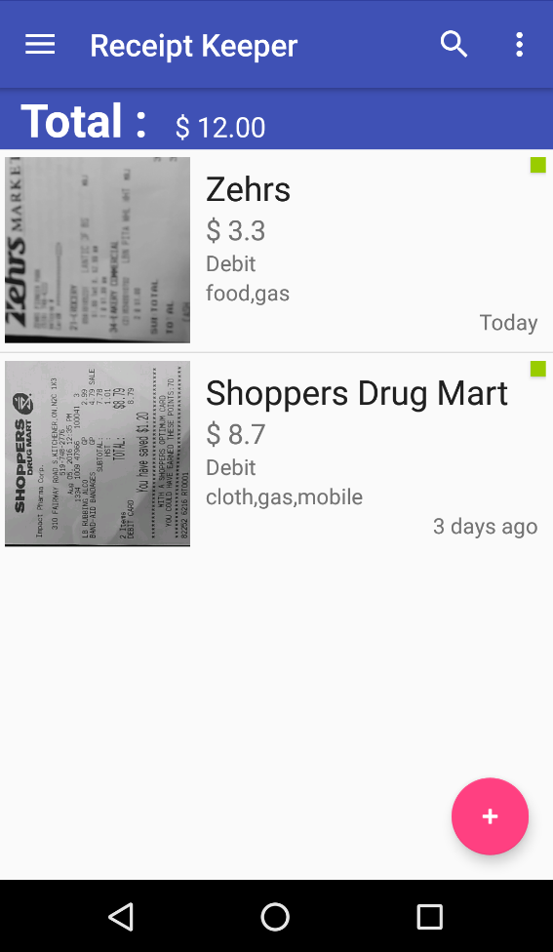
Features (mobile - cont.)
Filter
Web Sync.
Receipts
Filter results

Slide 13
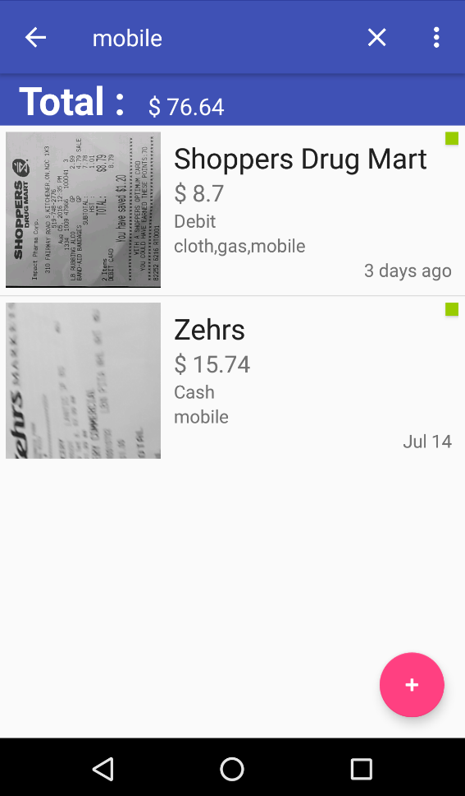
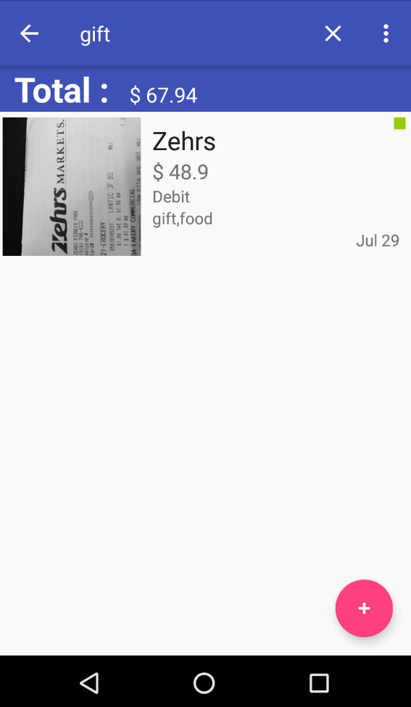
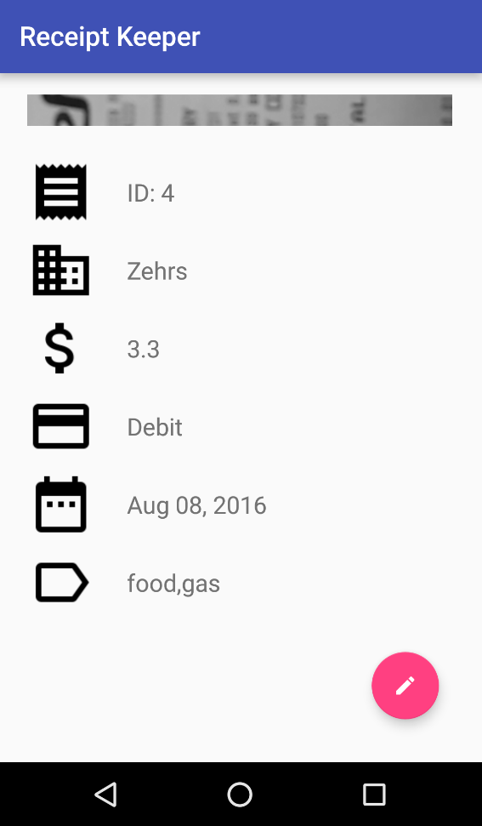
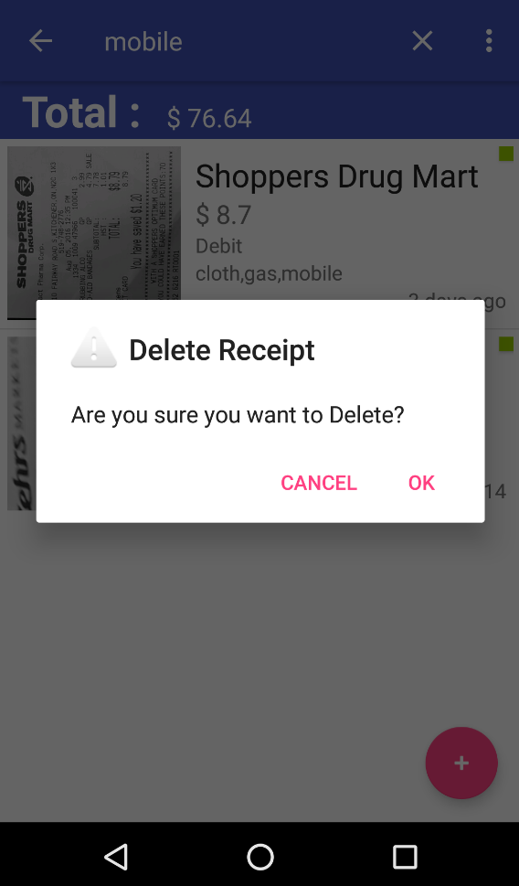
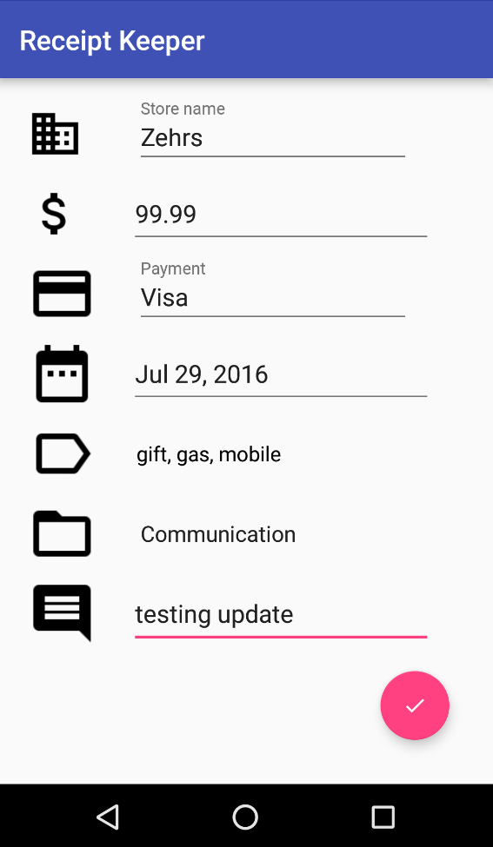
Features (mobile - cont.)
Short touch
Long touch
Update
View details
Delete

Slide 14

Features (web app)

Slide 15
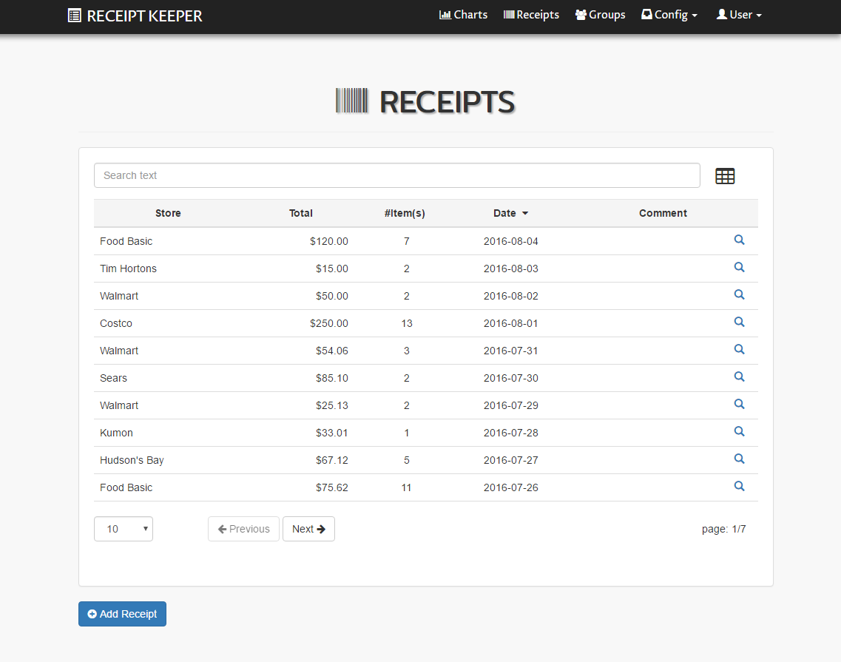
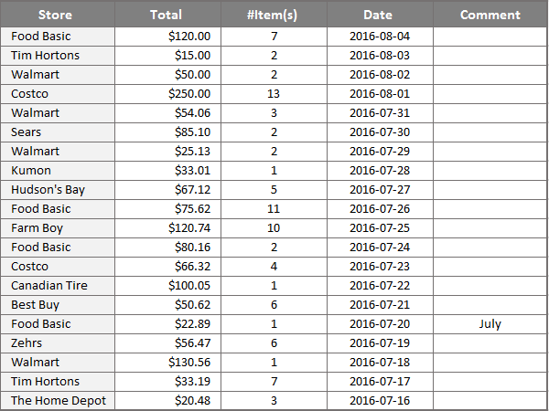
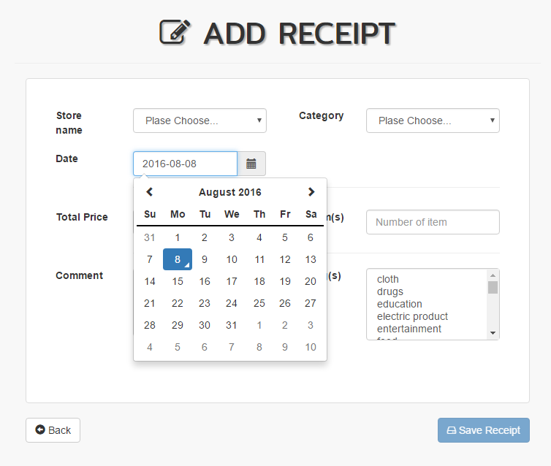
Features (web - cont.)
Search/ Sort/ Pagination/ Excel Export

Slide 16
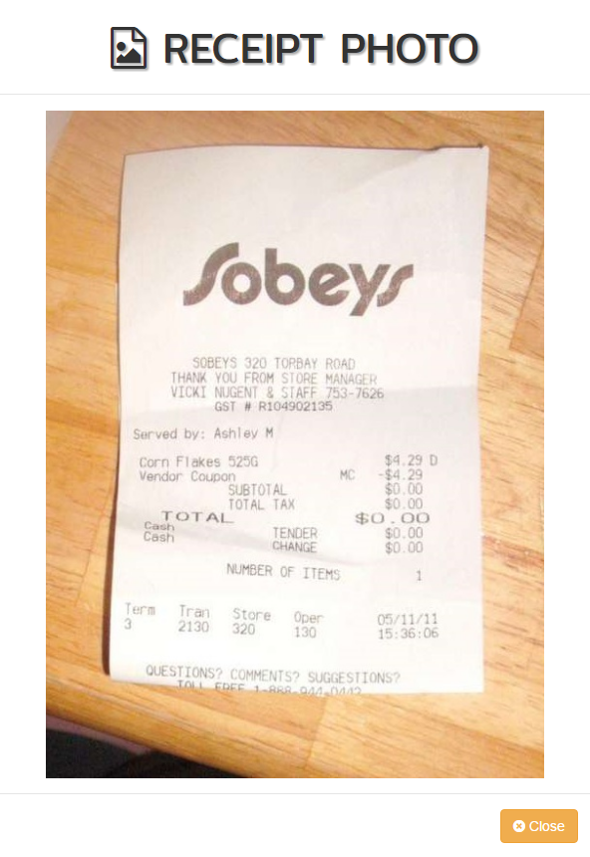
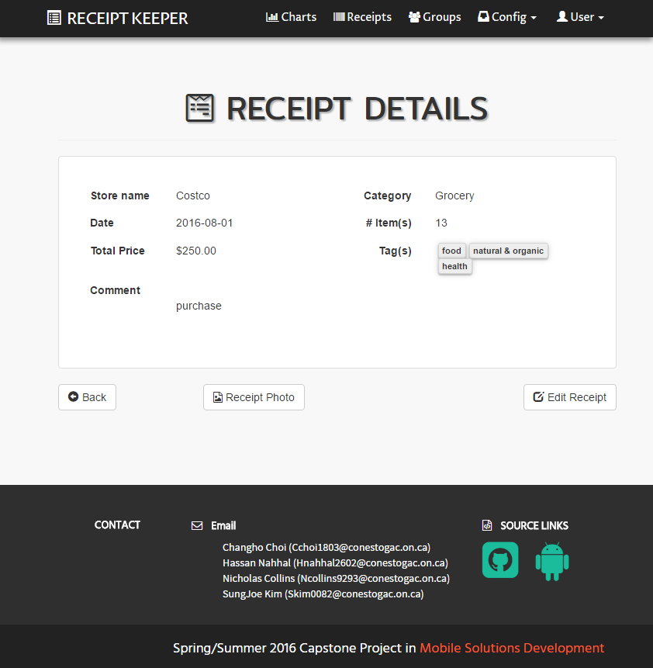
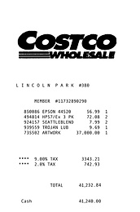
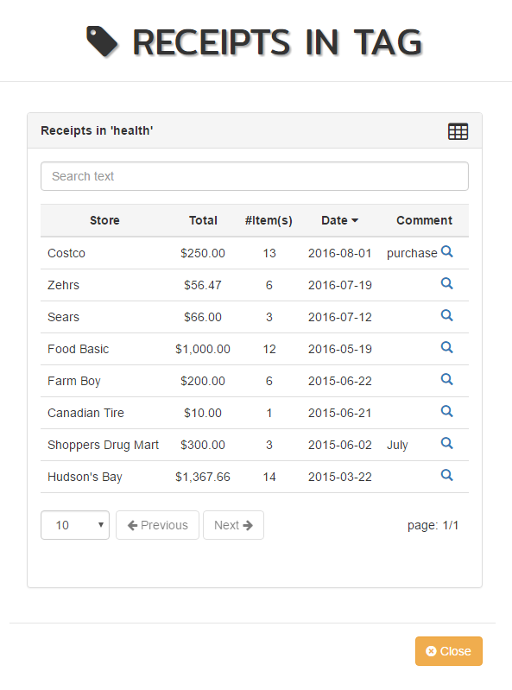


Features (web - cont.)
Receipt photo/ Extract receipts from tag

Slide 17
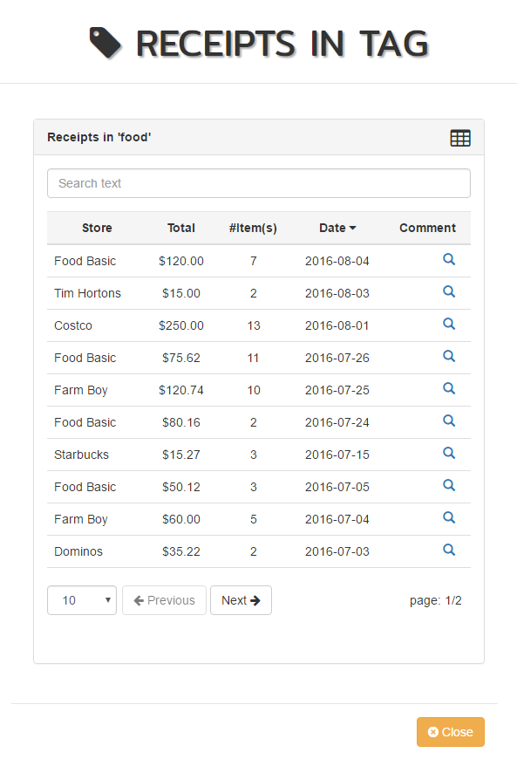
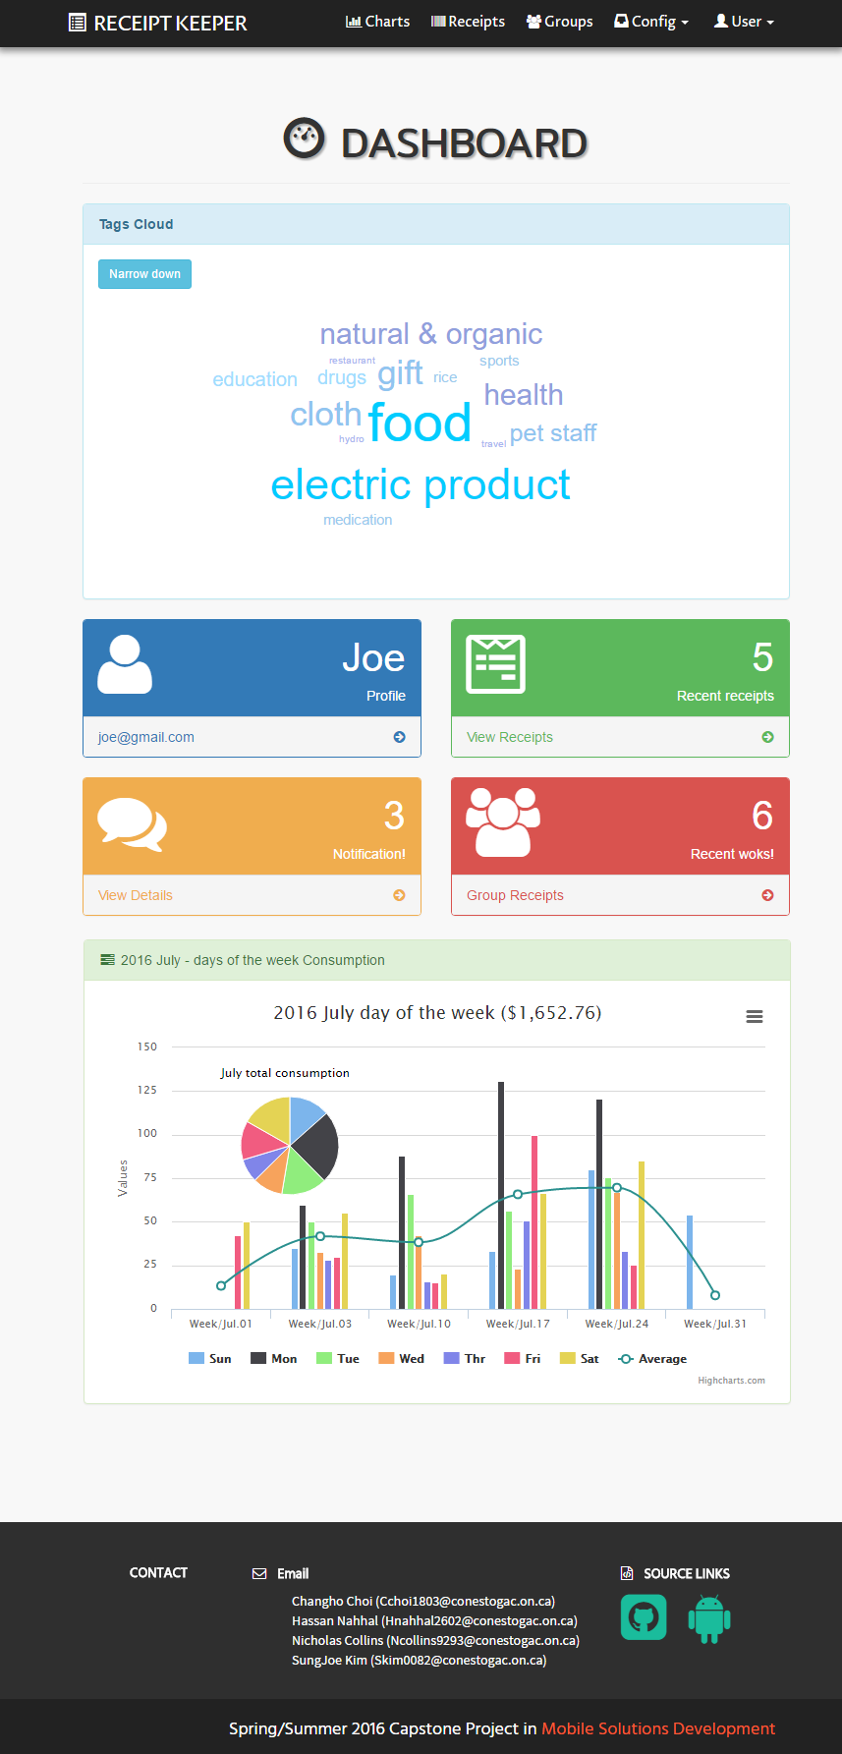
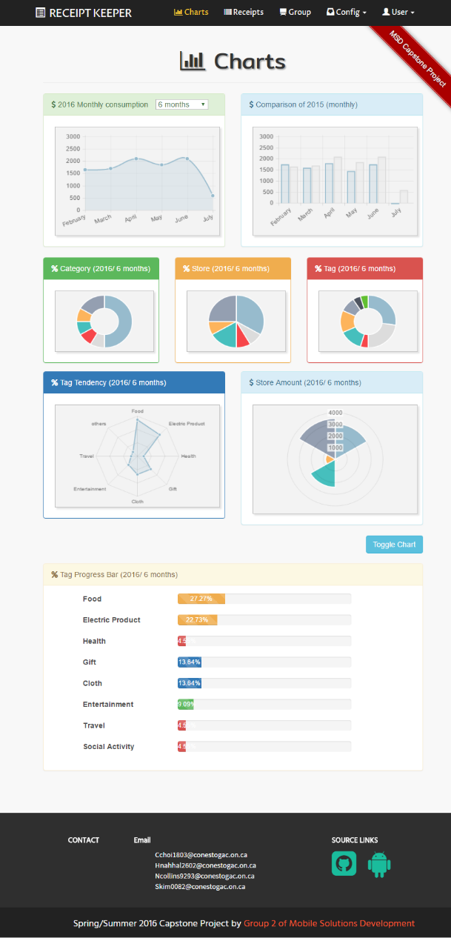
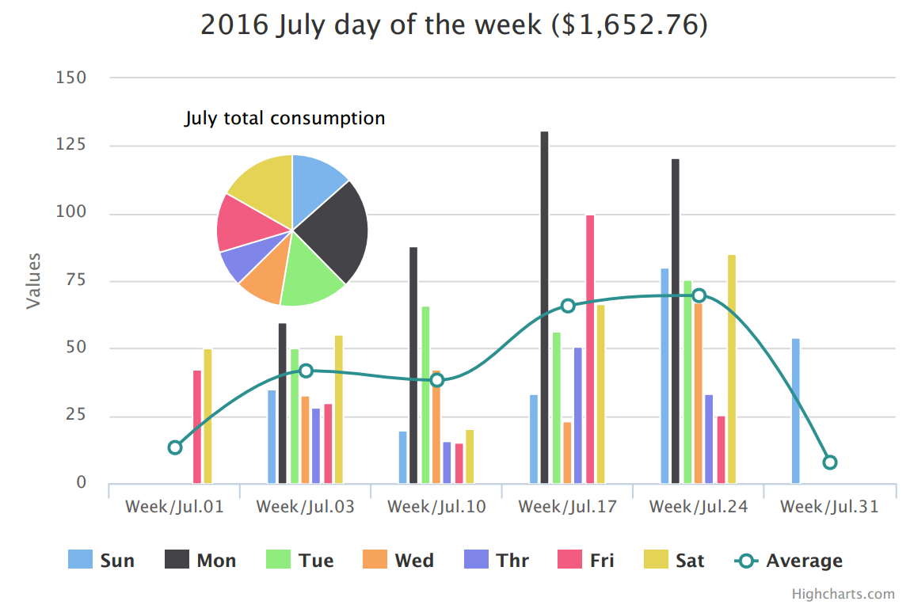
Features (web - cont.)

Slide 18
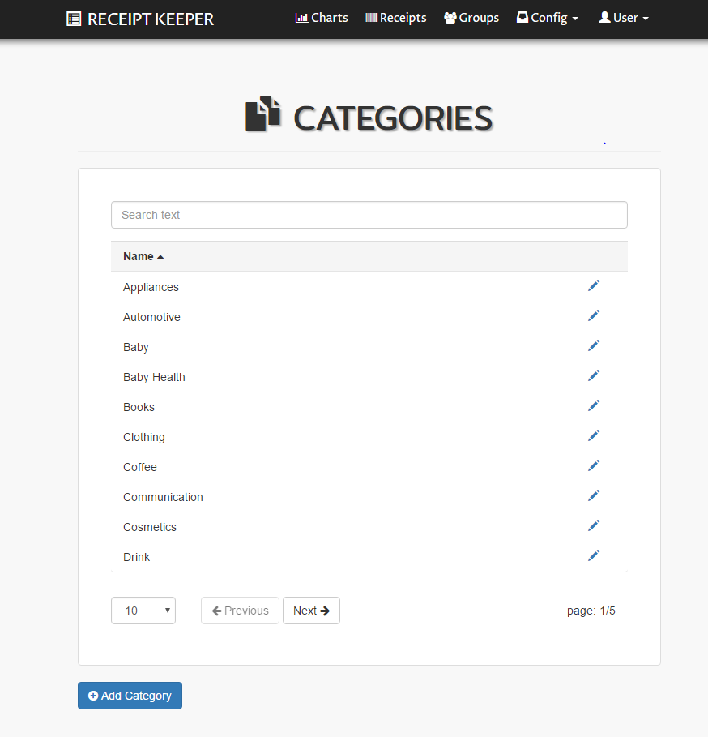
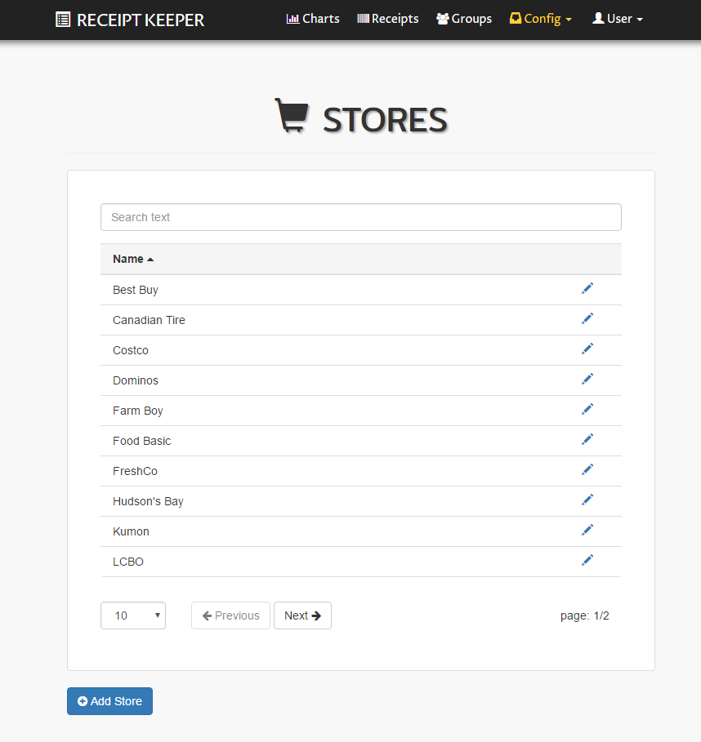
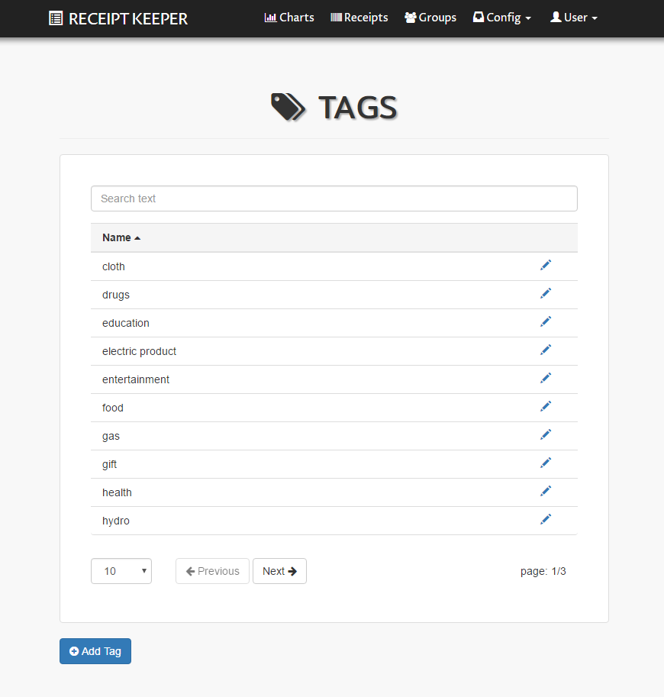



Features (web - cont.)
User organize data structure
Category/ Store/ Tag
View reports based
on them

Slide 19
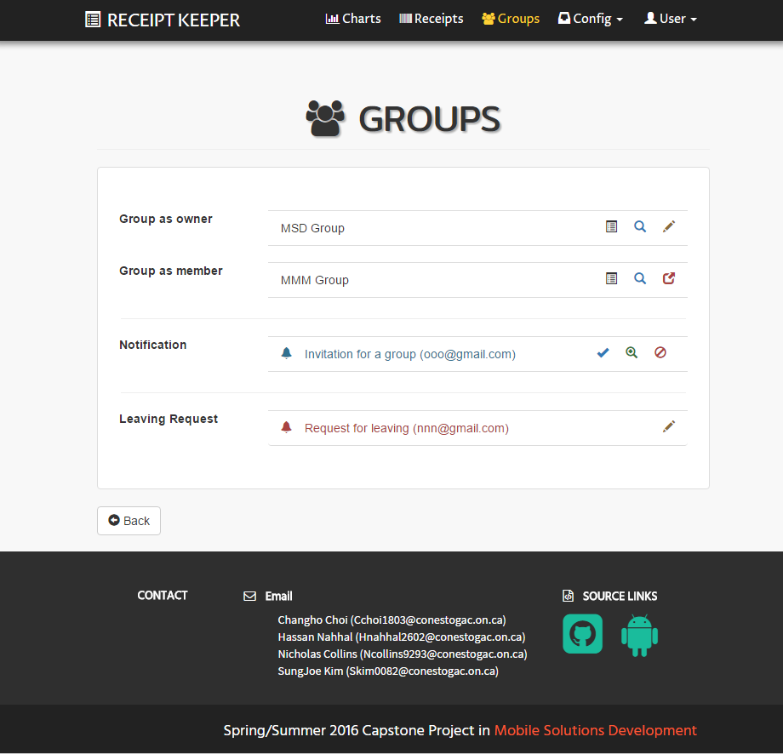
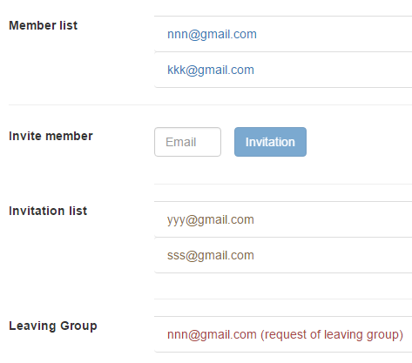

Features (web - cont.)
Create group
Works in group
Invite member
Store & Share

Slide 20

Future Plans
Save daily paperless receipts
Imp./Exp. with various formats
Switch between account type
Combine multiple images
OpenCV to improve accuracy
Track each member in group
Retrieve from specific item(s)
Notes:
Here, again Nick

Slide 21

Conclusion
Scan receipts with mobile devices
Save data local or online
Track spending
View and export reports as files
Provide various visual information
Access anywhere/ anytime
Support works in group

Slide 22





Team members
Changho Choi
Mobile UI/ Web Sync.
Hassan Nahhal
Mobile UI/ Back-End
Nicholas Collins
OCR/ Mobile Front-End
SungJoe Kim
Web UI/ Front/ Back-End
Notes:
Move this slide when Q&A sections

Slide 23
Thank you
for
your attention!
Receipt Keeper

Slide 24
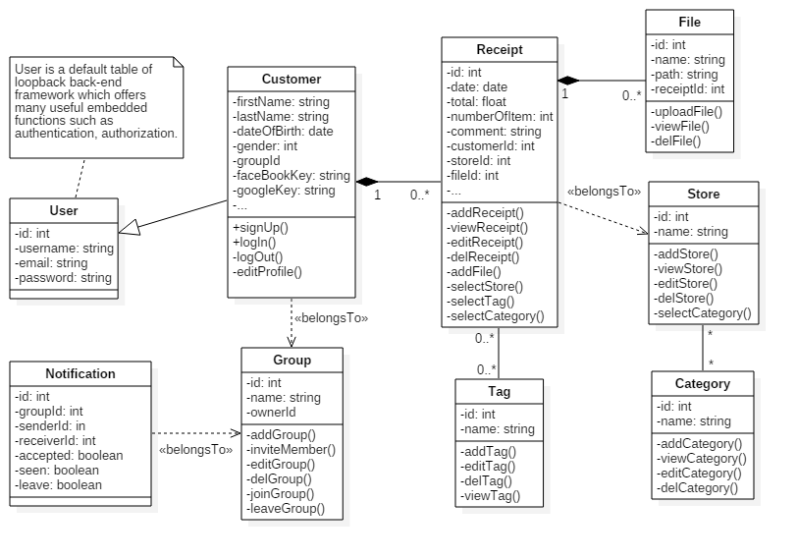

Diagrams (Details)
Back

